Slide 1


SCADA & RTU 560 Training
Barsam Global Solutions
Intelligent Stored Asset Management System

Slide 2
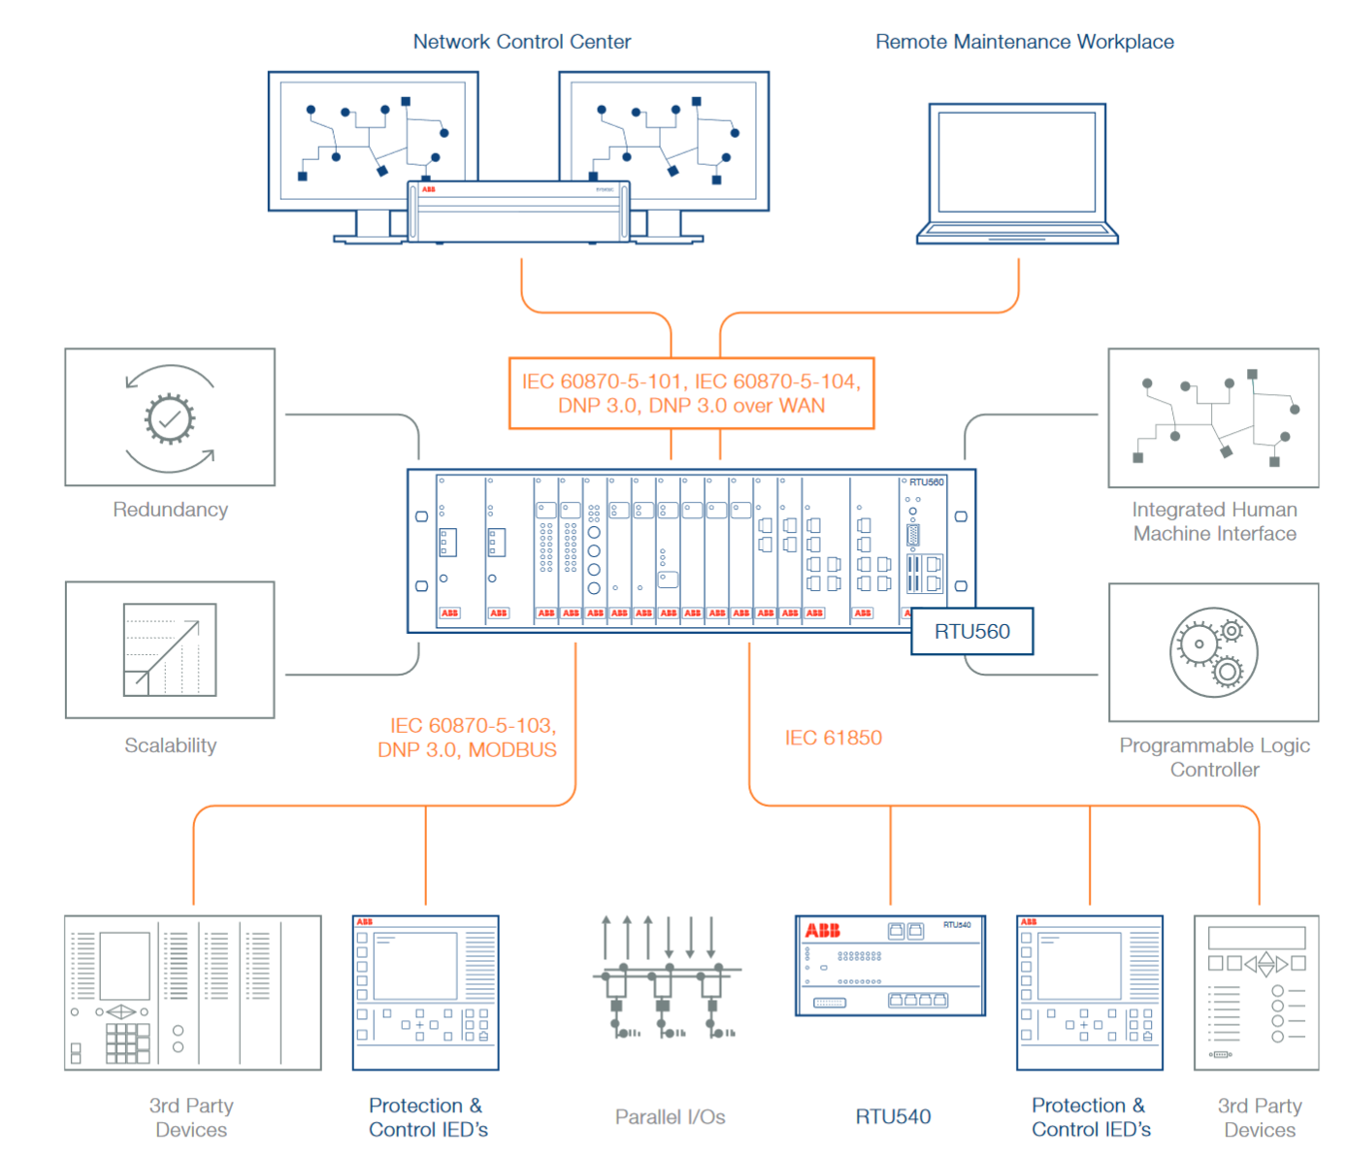

Barsam Global Solutions

Slide 3
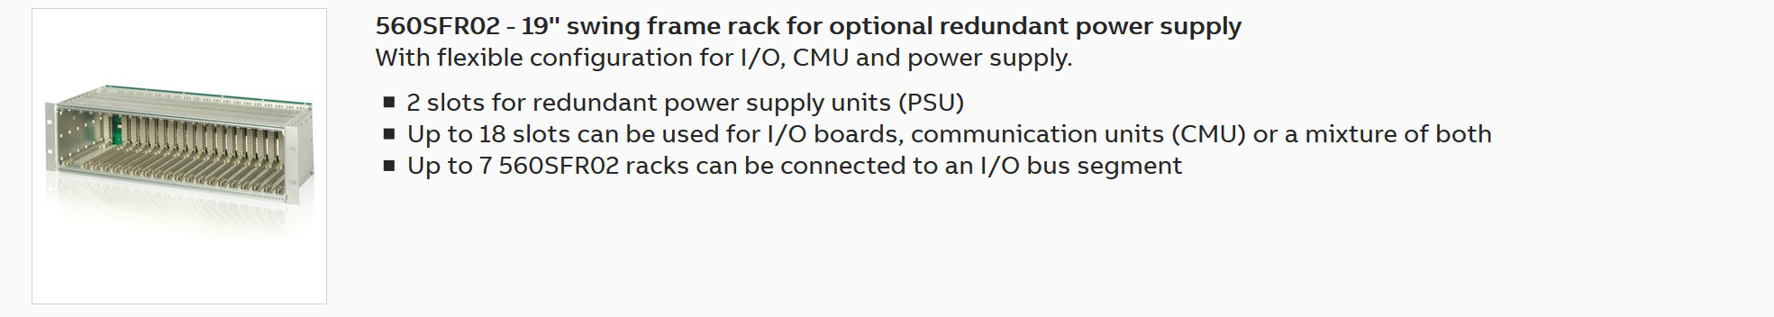
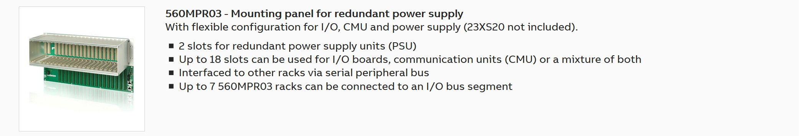
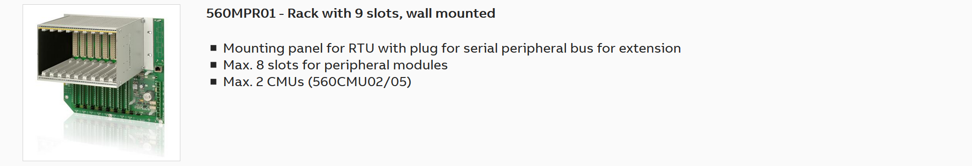
ABB 560 Subracks
Barsam Global Solutions

Slide 4
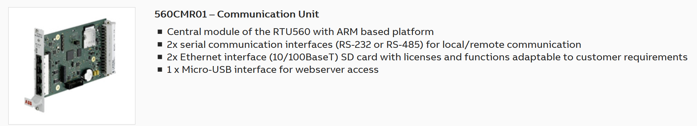
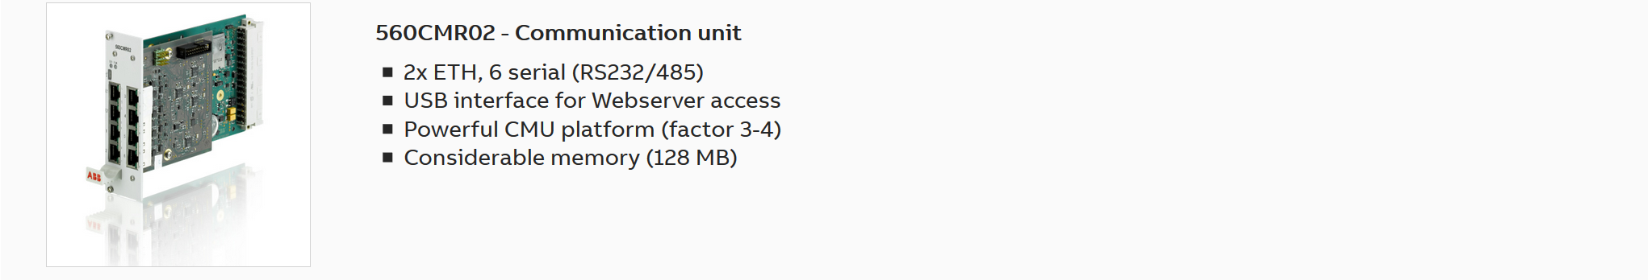
Communication Units
Barsam Global Solutions

Slide 5
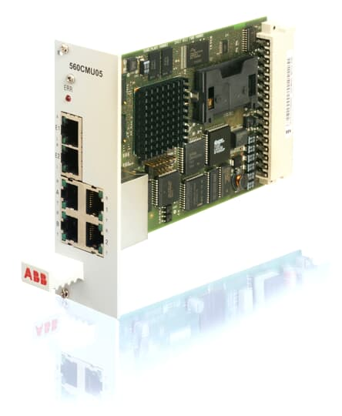
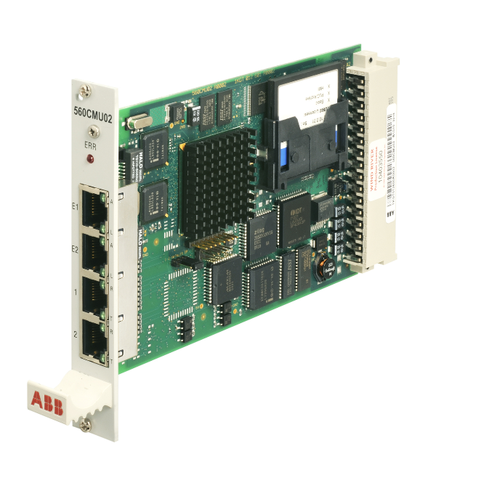
Communication Units
Old Modulus
Barsam Global Solutions

Slide 6
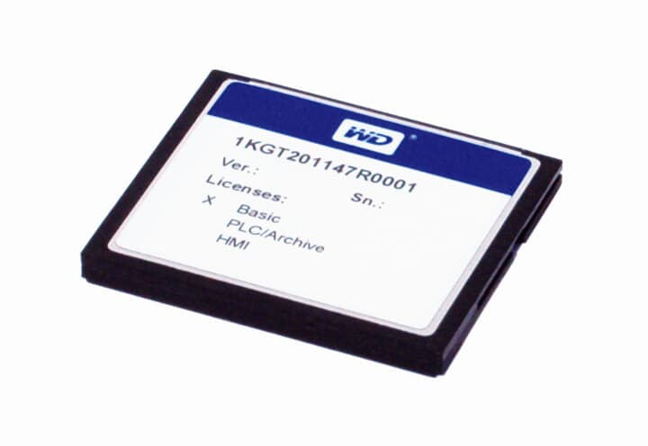
Communication Units
License CF & SD
Basic license open
HMI license
PLC/Archives license
50 , 250 , 750 , 5000 Data Point
Barsam Global Solutions

Slide 7
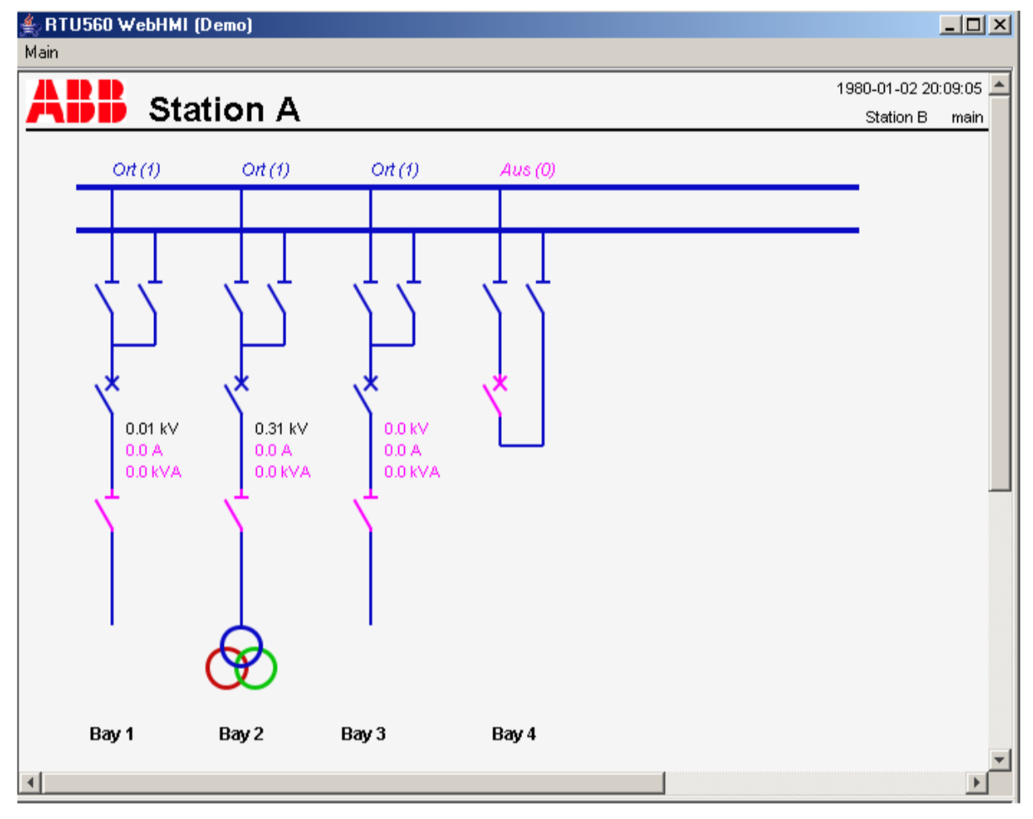
Communication Units
License CF & SD
HMI license
50 , 250 , 750 , 5000 Data Point
Barsam Global Solutions

Slide 8
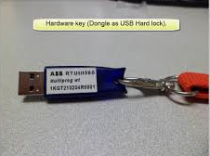
Communication Units
License CF & SD
PLC/Archives license
Programmable Logic Control (PLC)
Archive and Local Print Function
Disturbance Data Archive
Load Profile Archive
50 , 250 , 750 , 5000 Data Point
Barsam Global Solutions

Slide 9
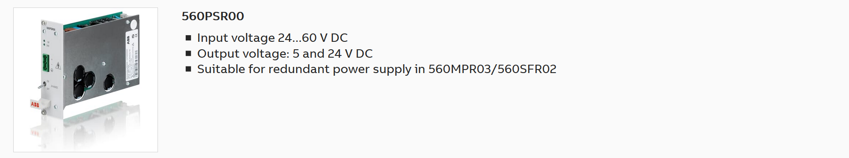
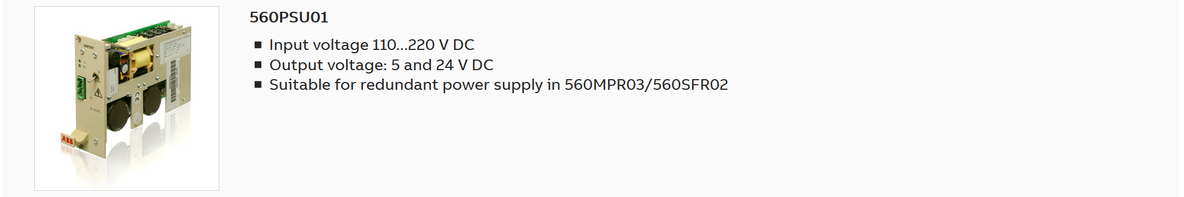
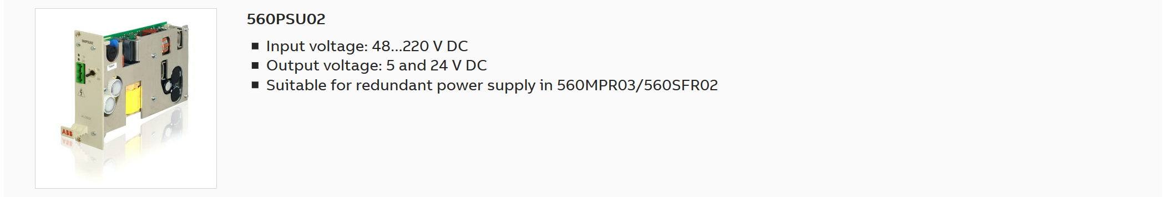
ABB 560 Power Supply Modules
Barsam Global Solutions

Slide 10
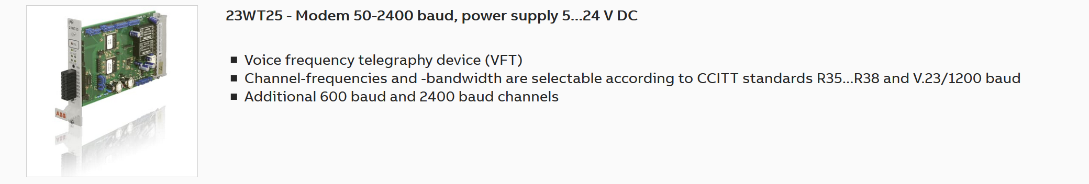
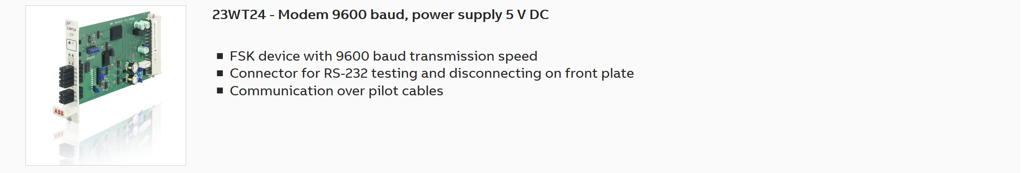
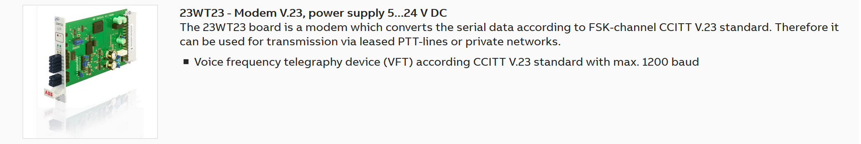
ABB 560 Serial Connection Modules
Barsam Global Solutions

Slide 11
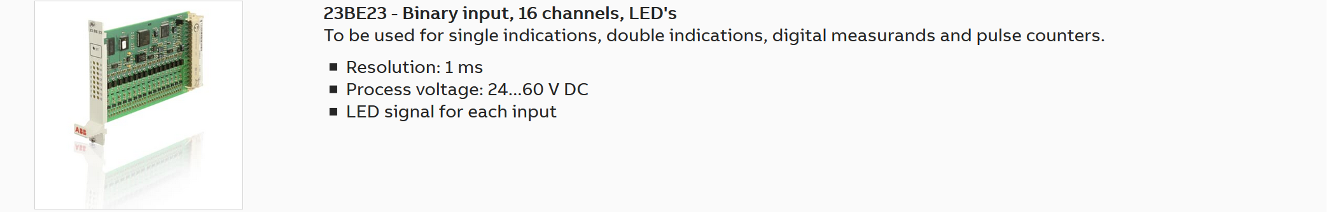
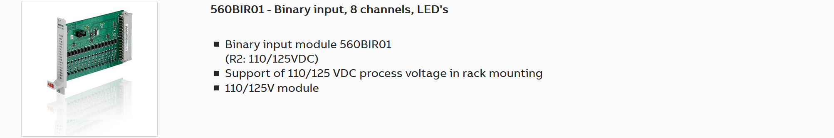
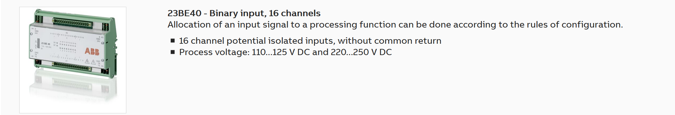
ABB 560 I/O Modules
Barsam Global Solutions

Slide 12
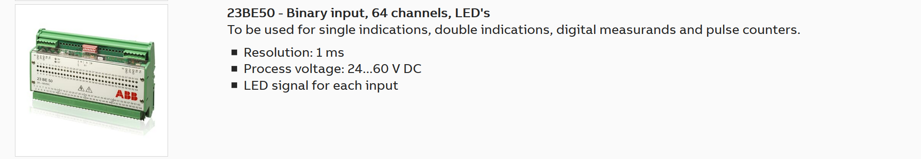
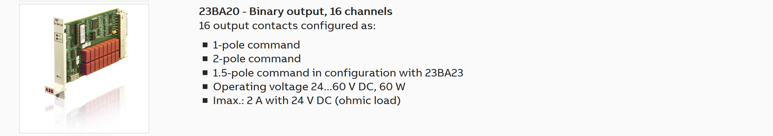
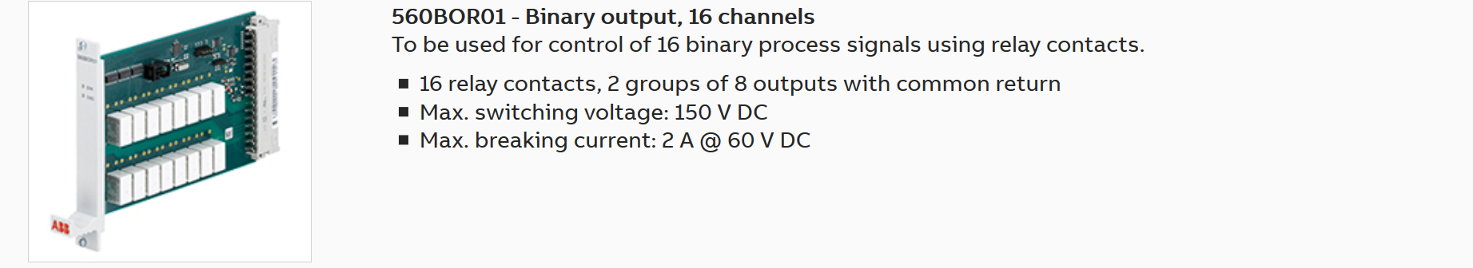
ABB 560 I/O Modules
Barsam Global Solutions

Slide 13
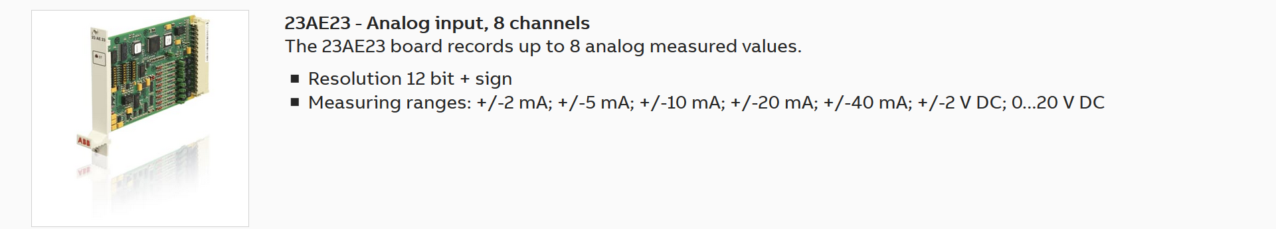
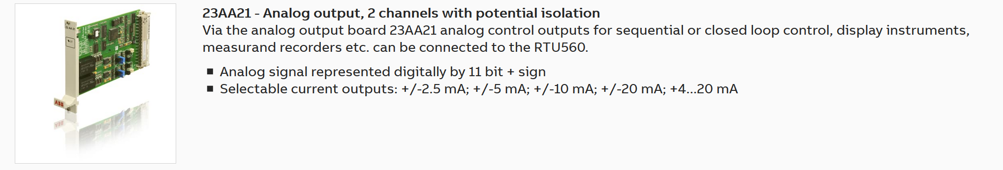
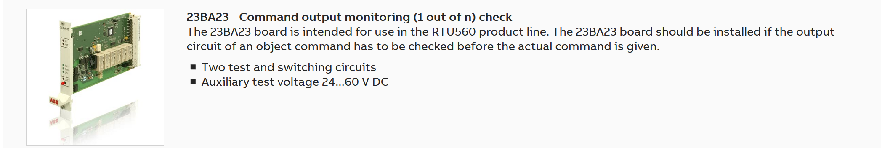
ABB 560 I/O Modules
Barsam Global Solutions

Slide 14
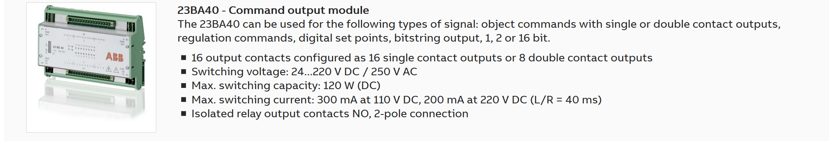
ABB 560 I/O Modules
Barsam Global Solutions

Slide 15
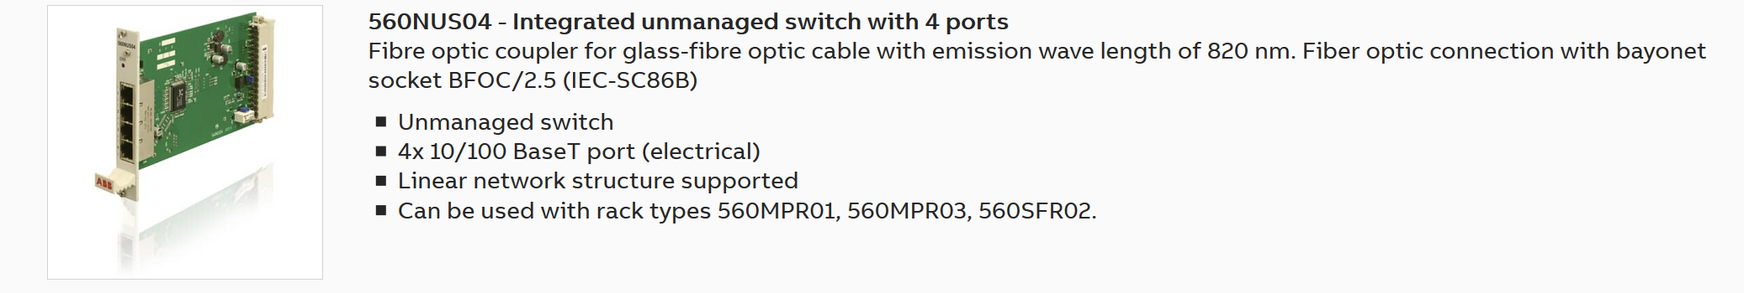
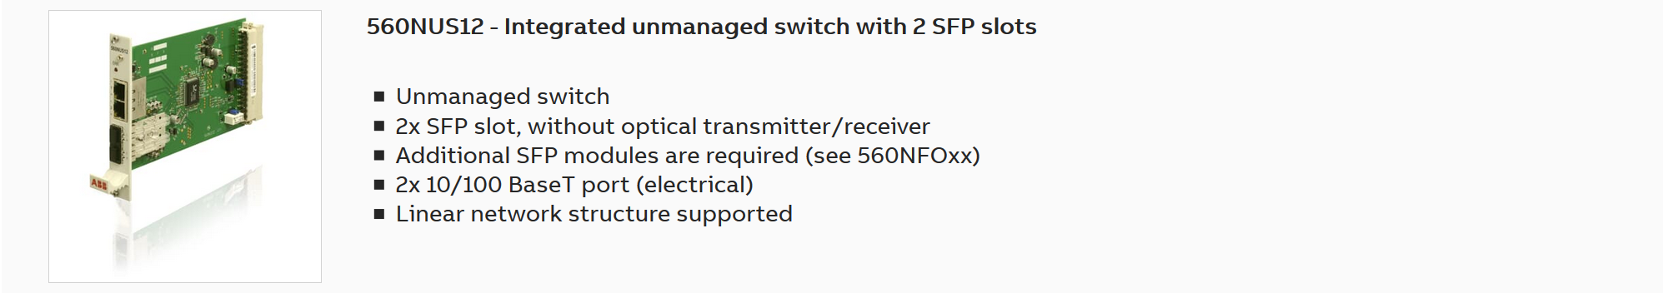
ABB 560 Network Modules
Barsam Global Solutions

Slide 16
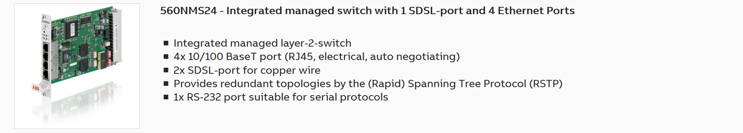
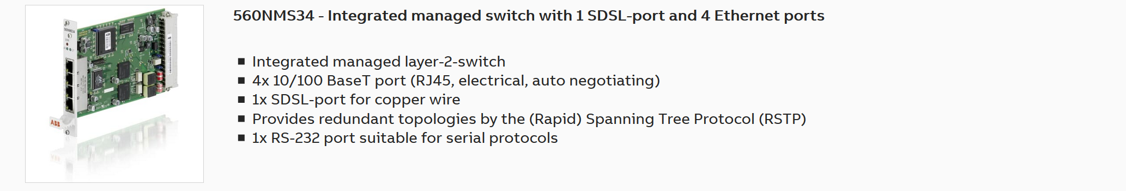
ABB 560 Network Modules
Barsam Global Solutions

Slide 17
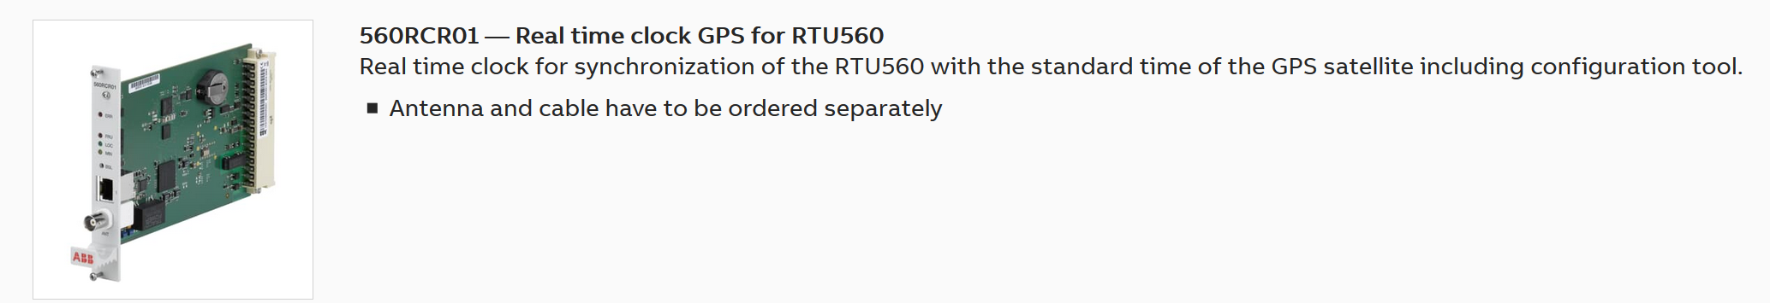
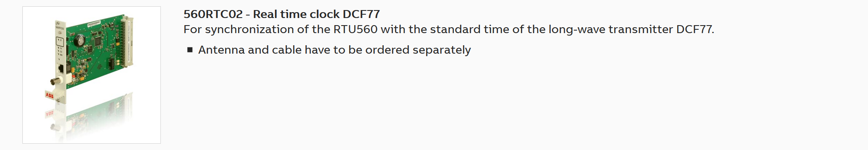
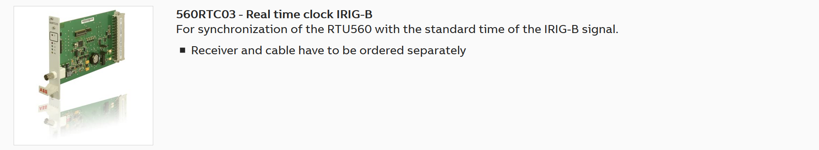
ABB 560 Realtime Clock Modules
Barsam Global Solutions

Slide 18
ABB 560 Realtime Clock Modules
Barsam Global Solutions

Slide 19
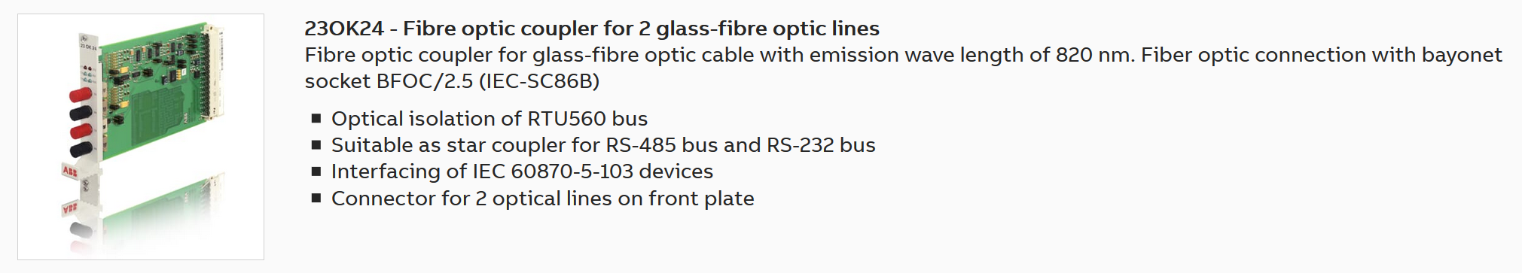
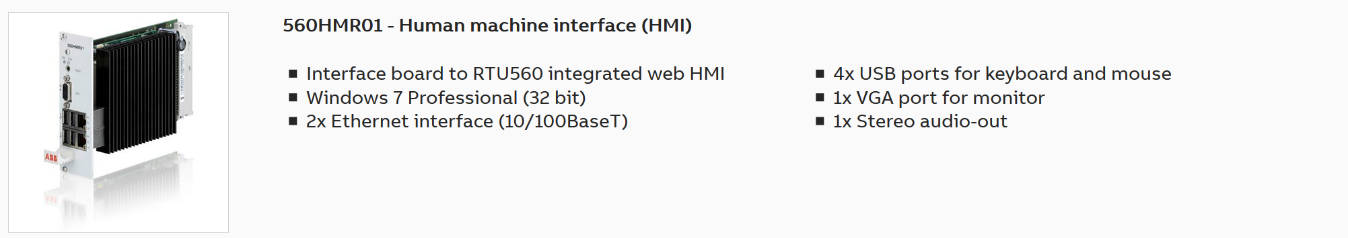
ABB 560 Special Modules
Barsam Global Solutions

Slide 20
ABB 560 License
Barsam Global Solutions

Slide 21



با تشکر
Barsam Global Solutions
Payam Ghaffari
+98 21 448 226 14/15
P.Ghaffari@bgsco.ir
www.bgsco.ir
Last Modified : Feb 18, 2020

